Slide 1
Digital Portfolio
Student Name : Tabsheer Ahmed
Register No and NMID: 31924U09026
Department : BCA
College / University : Mazharul Uloom College

Slide 2

AGENDA
Problem Statement
Project Overview
End Users
Tools and Technologies
Portfolio design and Layout
Features and Functionality
Results and Screenshots
Conclusion
Github Link
3/21/2024 Annual Review

Slide 3
PROJECT TITLE
PERSONAL DIGITAL PORTFOLIO

Slide 4
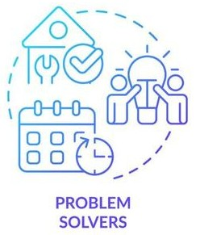
Problem Statement
Many students lack a structured platform to showcase academic and personal achievements. Traditional resumes are static and fail to demonstrate technical projects inter actively. Need for a modern, responsive, and interactive portfolio website.

Slide 5
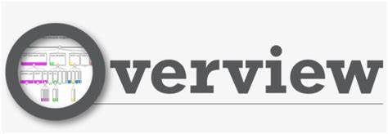
Developed a personal digital portfolio using HTML, CSS, and Java Script. Sections included: Home, About, Skills, Projects, Experience, Achievements, Contact. Provides professional identity and project showcase in one place.

Slide 6

End Users
Present academic and project work professionally. Recruiters: Quick overview of skills, projects, and qualifications. Peers & Faculty: Evaluate contributions and presentations of work.

Slide 7

Tools and Techniques
Frontend: HTML , CSS , JavaScript
Design: Responsive UI with Flexbox and Grid
Features: Smooth scrolling, navigation highlighting, filtering system for projects
Version Control : GitHub is for hosting option

Slide 8

Portfolio Design and Layout
Clean and modern design with professional color. Fixed navigation bar with smooth scroll. Hero section with profile introduction. Grid-based Projects Section with filter buttons (Skills, Personal, Research).

Slide 9

Features and Functionality
Projects Filtering: Easily filter academic, personal, or research projects.
Experience Timeline: Visual representation of internships and roles.
Achievements Section: Highlighting certifications and recognitions.
Contact Form Simulation: Collects inputs and shows alert message.

Slide 10
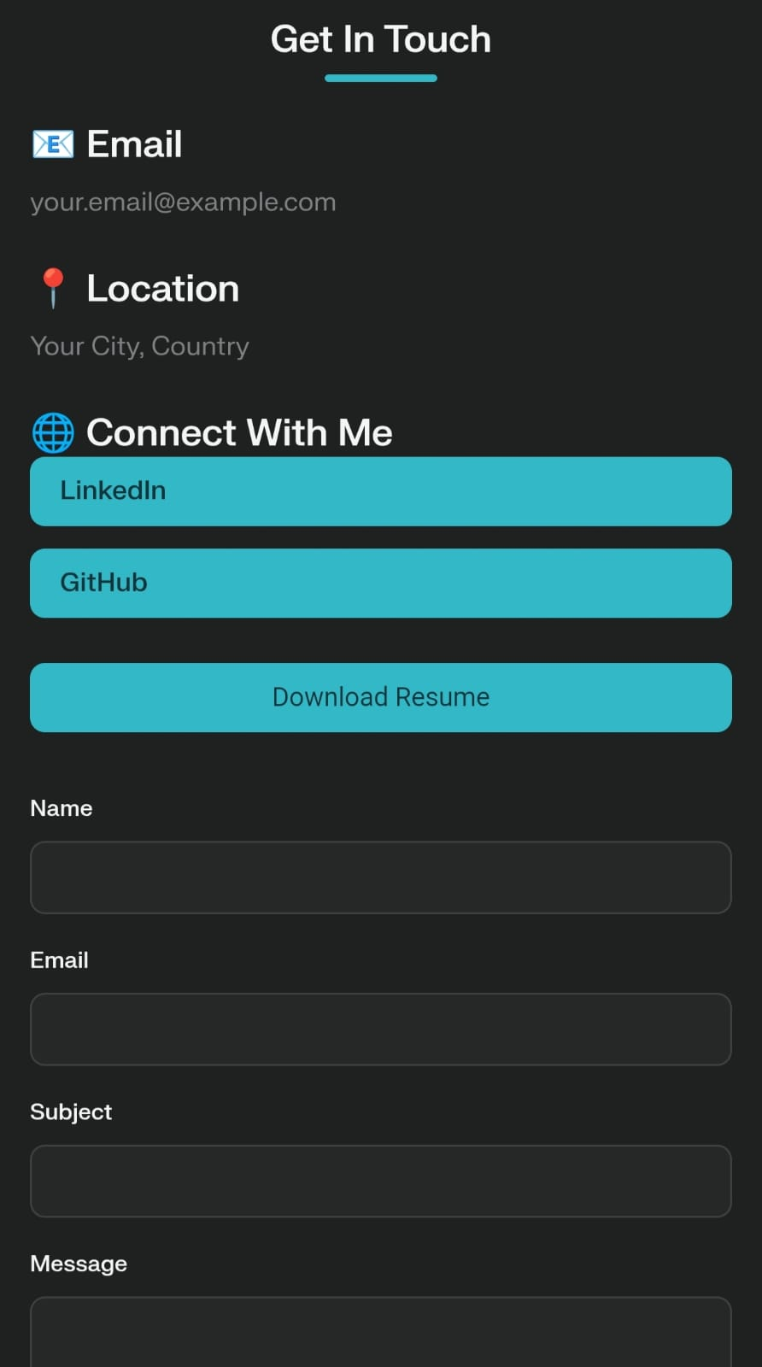
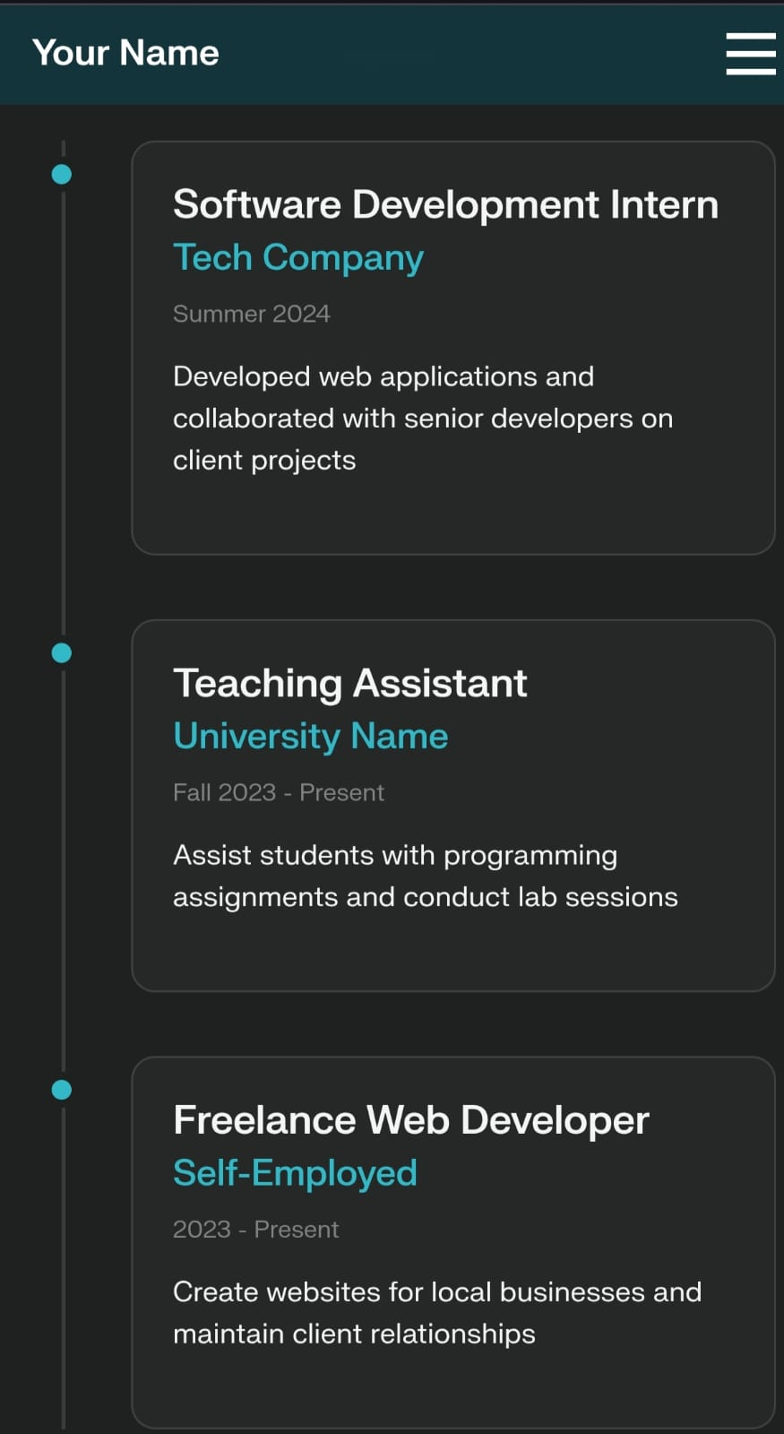
Results and Screenshots

Slide 11

Successfully developed a responsive personal portfolio website. Highlights academic achievements, technical skills, and projects effectively. Helps in career opportunities, networking, and professional branding. Future scope: Dark mode, blog integration, API-based project updates
3/21/2024 Annual Review
11

Slide 12
Get Hub Link
https://github.com/tabsheerahmed100506-arch

